Slide 1


Slide 2
Module Introduction & HTML
Computer Systems and Internet Technologies COMP1589
Matt Prichard

Slide 3

Agenda
Module Introduction
Lectures, Labs & Etiquette
The Internet
The Web
Web Development & HTML
Today’s Lab

Slide 4
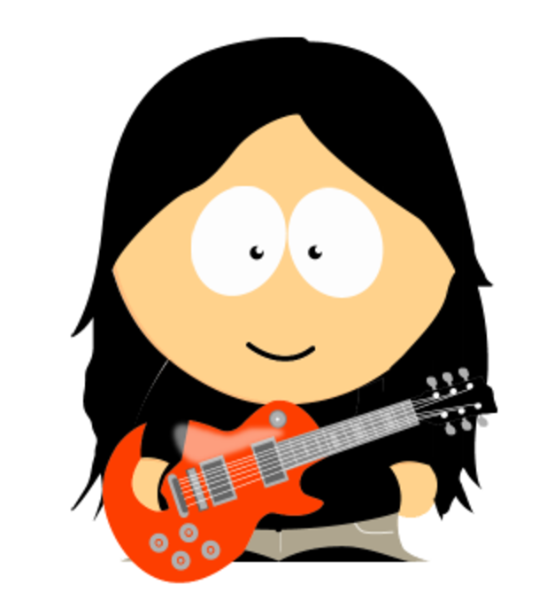
Who am I?
Matt Prichard
No ‘t’ in Prichard
Not Matthew
Not Sir
Call me Matt
I tend to swear a bit - sorry in advance.
Oh btw this is not school, you don’t have to put your hand up to go to the toilet.

Slide 5

About me
Been teaching here for 19 years
Have run a print and design company, worked as a web designer/developer, Mac artworker and a touring musician.
2 kids of university age
Go to many gigs and festivals
Metal, tech metal, progressive metal, Djent, metalcore, technical death metal, math metal, groove metal, anarcho-punk, hardcore, 90’s hiphop, ska and dub reggae.

Slide 6
12 Weeks (Term 2)
Timetable
Lectures (KW315)
Introduction to technologies, techniques and terminology.
Wednesdays 9am - 11am
Labs (KW215, KW216, KW116 Blue,QM015)
Interactive sessions providing practical experience for the subject. Wednesdays 11am - 12pm (KW215, KW216, QM015) Wednesdays 12pm - 1pm (KW216, KW116 Blue, QM015)
I don’t assign the labs.
Check your individual timetable at timetable.gre.ac.uk

Slide 7
This is a mixed module, meaning we have a mix of students from different academic backgrounds.
The Module
You may already know some of what we will cover, if so then help each other out.
Throughout this module we will be looking at the whole lifecycle of internet technologies, speciﬁcally focused on web systems.

Slide 8
There is a lot of ground to cover - ask plenty of questions!
The Module
We will be covering the complete development process of a website throughout our labs, whilst also touching on more advanced topics and techniques in our lectures.
There is a lot of information to digest with plenty of terms and acronyms to learn, so please make sure you take plenty of notes and ask questions.
You can ask questions by raising your hands in the lecture or lab, by Moodle and by emailing me directly.
If you need any further support, outside of this module, then please contact wellbeing@greenwich.ac.uk

Slide 9
This module is 100% coursework based, you need to get at least 40% to pass.
Assessment
Details
35% for 7 weekly tasks
65% for portfolio website
More details will be provided later in term
Hand in week 11
Week 12 will be info about moving to year 2

Slide 10
Lectures & Labs
The Module
Lectures
Registration will be by QR code scan or card tap in the lecture break
Every lecture will have a short break around halfway
Lectures will be split into two segments, the ﬁrst half focused on a speciﬁc topic and the second half focused on the lab task
Labs
Registration will by QR code scan or card tap at the start
The lab content is accessed via Moodle
During the labs please ask questions

Slide 11
Kahoot quizzes
The Module
Some weeks I will run a 10 question Kahoot quiz at the start of the session to review the previous week’s work.

Slide 12
Etiquette Expectations
The Module
Talking
During lectures please do not talk whilst the content is being delivered or whilst someone else is speaking. If you have a question, please raise your hand.
Arriving Late
If you arrive late to the lecture or lab please come in quietly and take the closest seat, if you need to register then let me know at the end.
Devices & Headphones
During lectures, please remove your headphones and try not to watch videos or play games on your devices.
Short and sweet: if you don’t want to be here then don’t be

Slide 13
Questions so far ?

Slide 14
The Internet

Slide 15
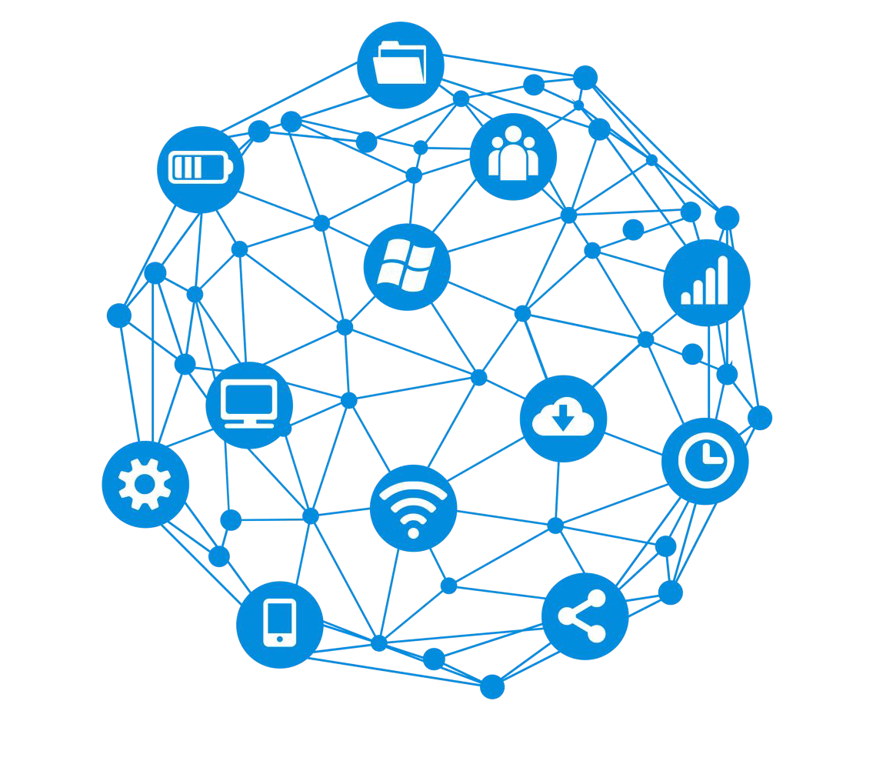
What is the internet?
“It is a network of networks that consists of private, public, academic, business, and government networks of local to global scope”
It allows multiple networks across the world to talk to one another via a mass of cables, computers, data centres, routers, servers, repeaters, satellites and wiﬁ towers.
All these networks utilise the Internet protocol suite, primarily TCP/IP.

Slide 16

History of the Internet
In the 1950s, ARPA scientists could not easily communicate or share information between the universities they were based at.
To solve this problem they created a network of computers, which they called ARPANET. Realising how useful ARPANET was, other organisations built their own networks. However, these individual networks could not easily communicate with each other.
In the 70s, a protocol was developed called TCP/IP. This protocol allowed separate networks to communicate with each other, joining these individual networks created a huge wide area network (WAN) which came to be known as the internet.

Slide 17
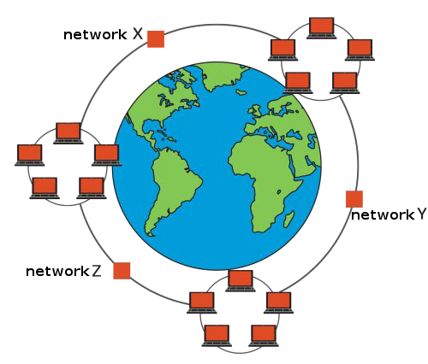
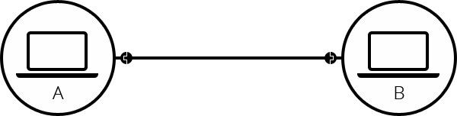
How the internet works
For computers to communicate you must connect them together, this can usually be done by something like an ethernet cable.
Simple enough, however if we want to connect 10 computers together it gets more complicated and we’d need 45 cables and 9 ports per computer.
This is where routers come in, once we add a router to the system, our network of 10 computers only requires 10 cables: a single port for each computer and a router with 10 plugs.

Slide 18
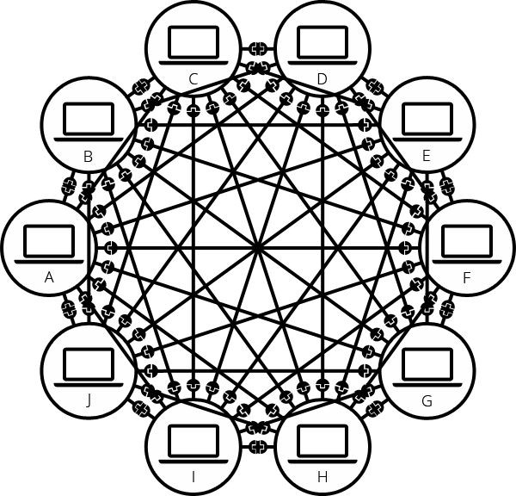
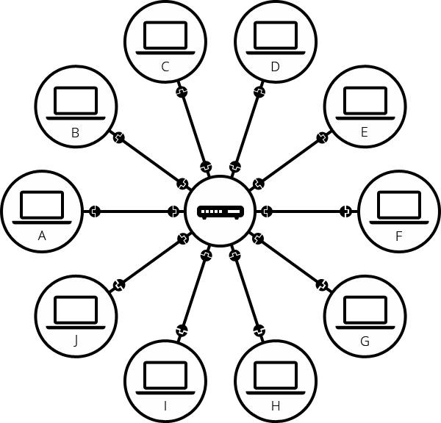

With Router
Without Router

Slide 19
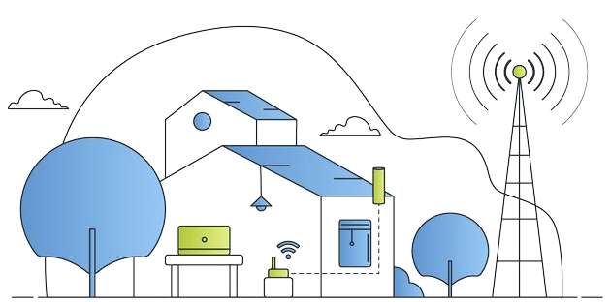
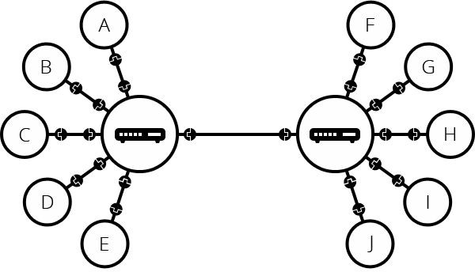
How the internet works
Now we have introduced a router into the equation we can then consider connecting routers together, this makes it much more scalable.
Except we are now only connecting our local networks together, this is our Local Area Network (LAN).
This is where the internet comes in, utilising Internet Service Providers (ISP), we can connect our networks to other people's networks via our ISP.

Slide 20
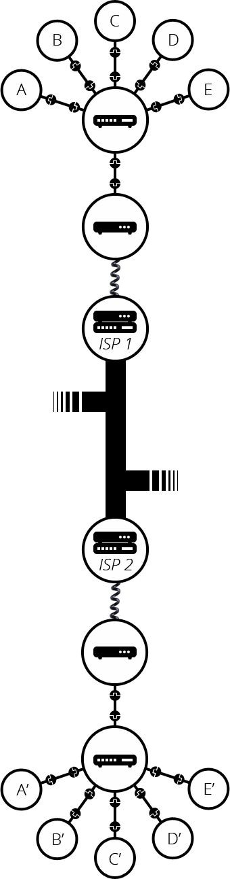
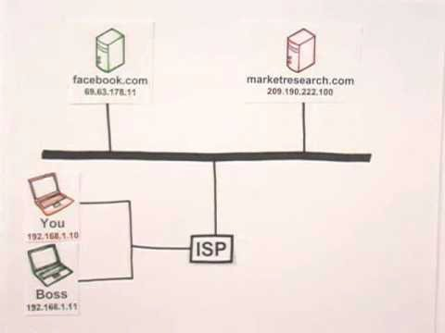
With ISP

Slide 21
The Web

Slide 22

World Wide Web
Many people think that the internet and the world wide web are the same thing. While they are closely linked, they are very different things.
In 1989 Sir Tim Berners-Lee was trying to ﬁnd a new way for scientists to easily share the data from their experiments.
His solution, the world wide web, utilising his Hypertext Transfer Protocol (HTTP) to communicate between the client and server on the internet.
The web meant that computers connected to the internet could share this data via web pages.
Internet is a global network of computers all connected together.
World Wide Web (www/web) is a collection of webpages found on this global network of computers.

Slide 23
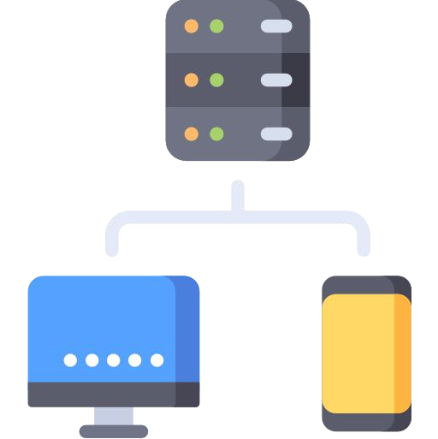
Client-Server Model
The client-server model is the relationship between two computers in which one, the client, makes a service request from another, the server.
The key point about a client-server model is that the client is dependent on the server to provide and manage the information.
For example, websites are stored on web servers. A web browser is the client which makes a request to the server, and the server sends the website to the browser.

Slide 24
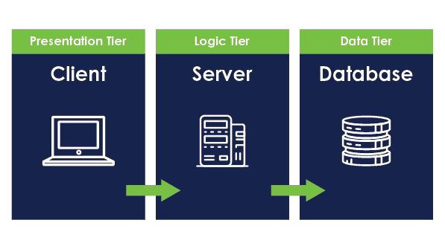
Web Architectures
When we are talking about client-server infrastructure the most common architecture is known as the three-tier architecture.
This is a logical and physical architecture deﬁning the tiers of computing systems used, these are split into:
Presentation Tier (User Interface)
Application/Logic Tier
Data/Storage Tier
These tiers represent a split between what we present to the user, how we handle the complex stuff and where we store the data.
Most modern applications are now moving to more complex conﬁgurations within the cloud.

Slide 25
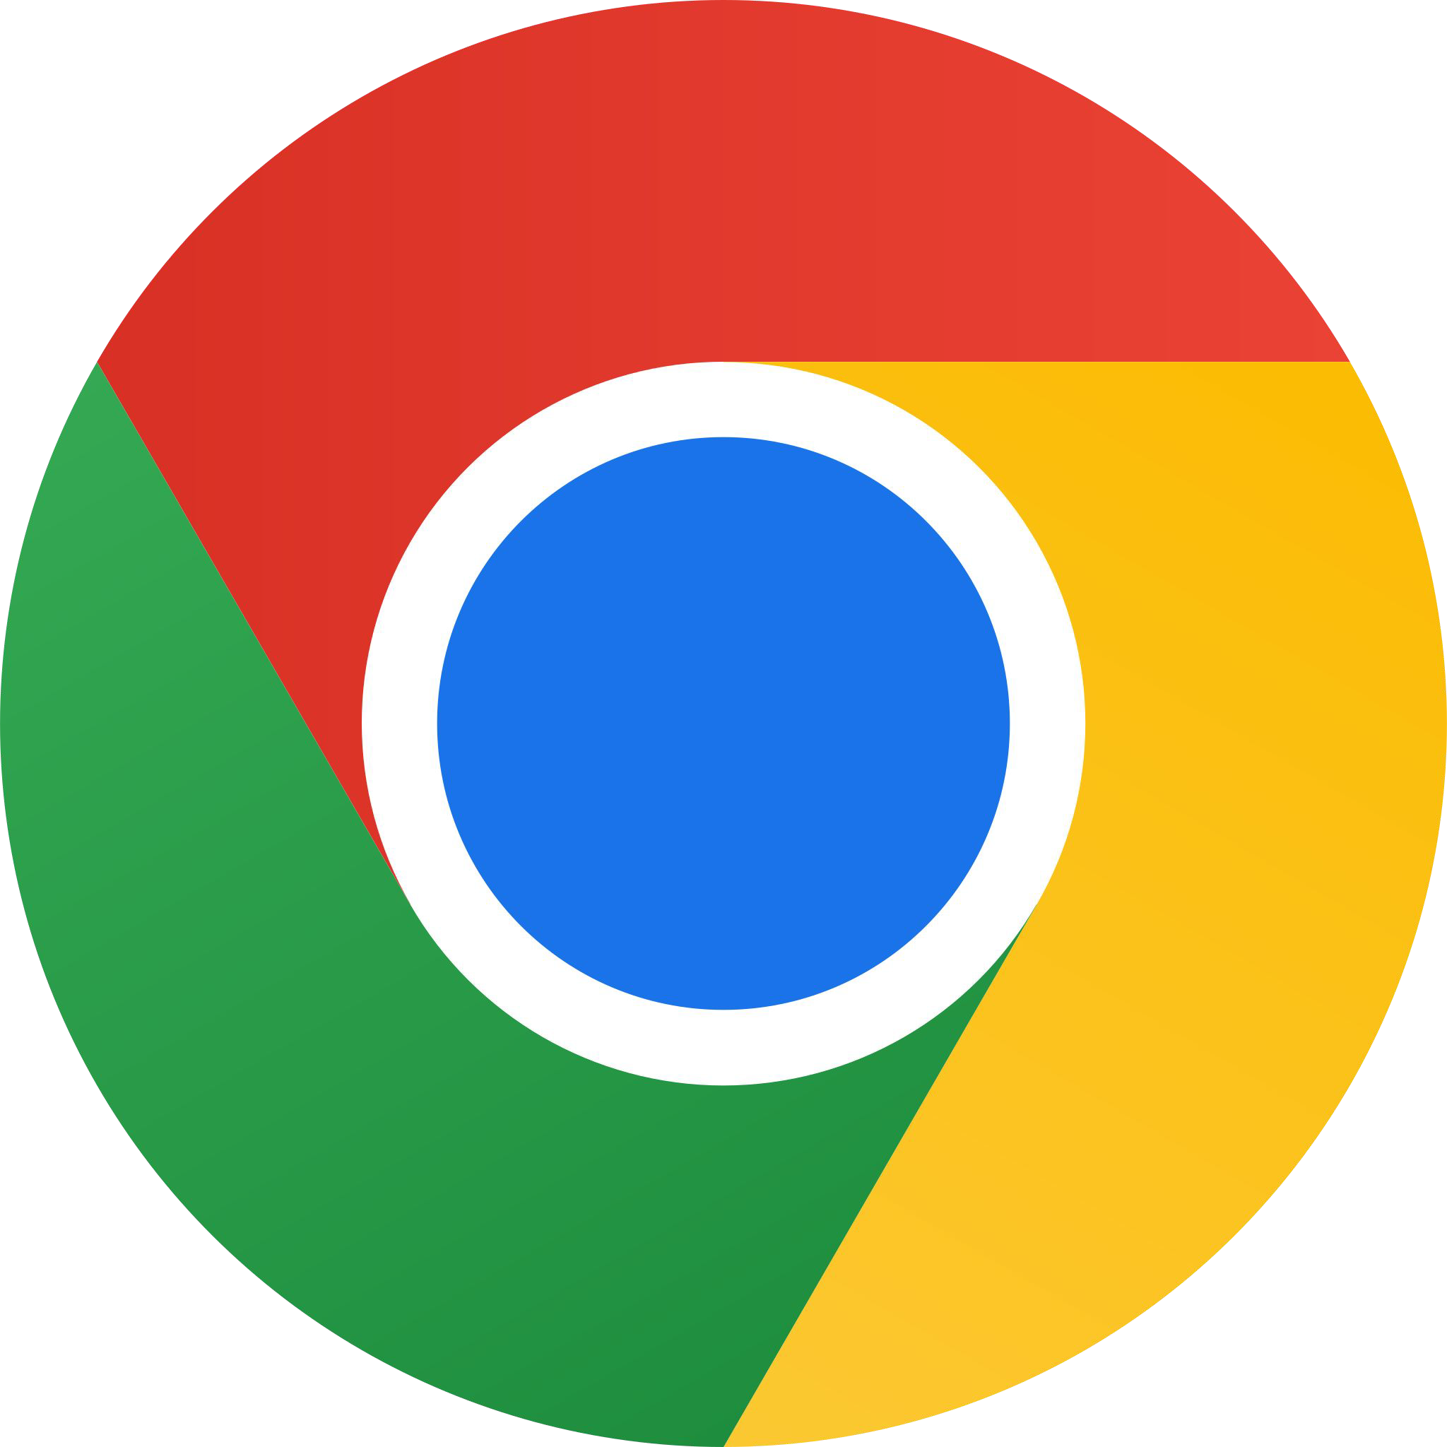
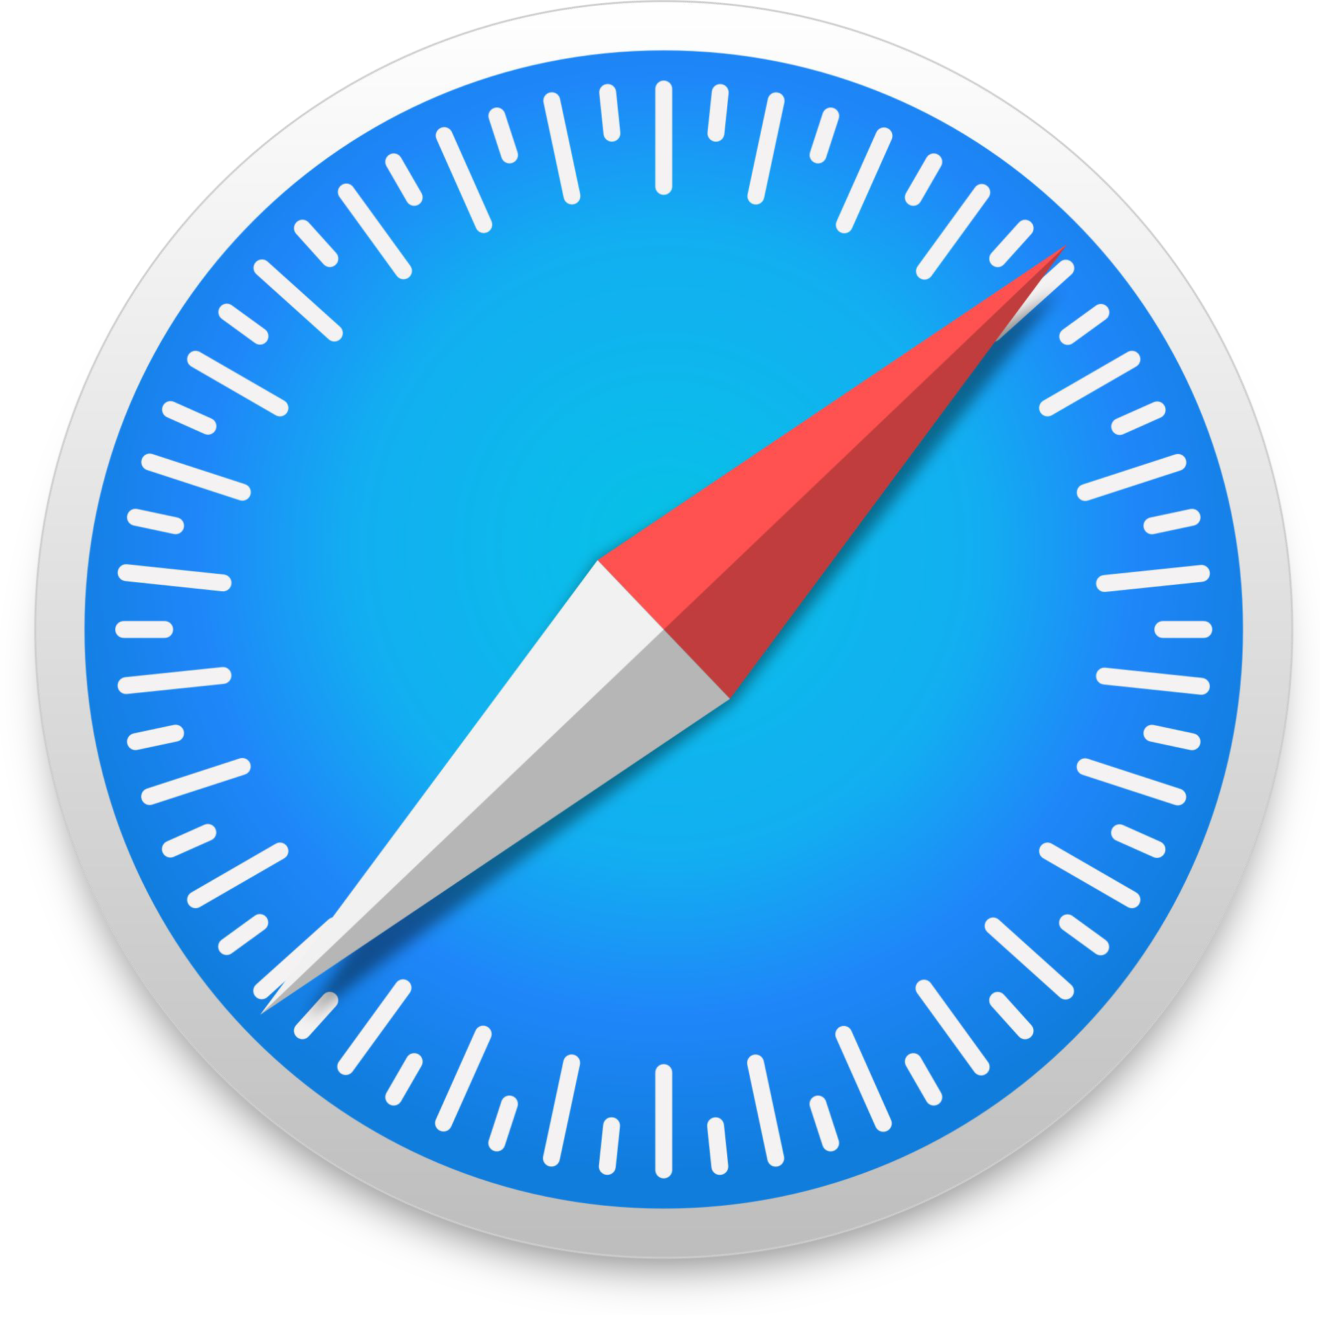


Browsers
We are all familiar with accessing the web via a web browser. It retrieves information from parts of the web displays it on your device.
This information needs to be shared and displayed in a consistent format so that people using any browser, anywhere in the world can see the information.
Sadly, not all browser makers choose to interpret the format in the same way. For users, this means that a website can look and function differently. Creating consistency between browsers, so that any user can enjoy the internet, regardless of the browser they choose, is called web standards.
The W3C speciﬁcations, primarily, determine how markup language and styles should be interpreted.
https://www.w3schools.com/browsers/default.asp

Slide 26
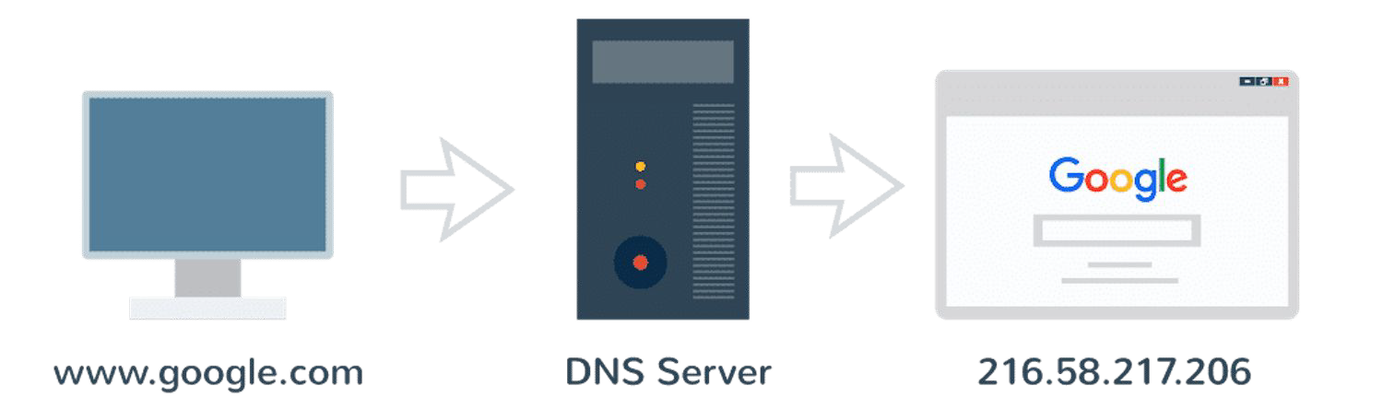
URLs & Domain Names
We will look at these in more depth later in the term, for now we’ll look at the basics.
When you want to visit a website, or anything in your browser, you’d go to the address bar and enter the web address - this is known as the Uniform Resource Locator.
The URL often, but not always, starts with the domain name. This is the address for this speciﬁc website, each web page generally has its own URL but a shared domain name.
Domain names consist of a hierarchical sequence of names separated by periods and ending with an extension.
Each domain name on the internet will relate to at least one IP address, this is the computer readable address.

Slide 27

Websites & Web Pages
Many people will mix the word website (site) with the term web page, there is however a slight difference.
Think of the same way there is a difference between a folder and a ﬁle, this is the equivalent.
A website is a collection of web pages which are grouped together often under a single domain.
A web page is the actual document which can be displayed in a web browser.
We create web pages and link them together to make a website.
Realistically it doesn’t matter too much which terminology you use as often they are used to refer to the same thing.

Slide 28
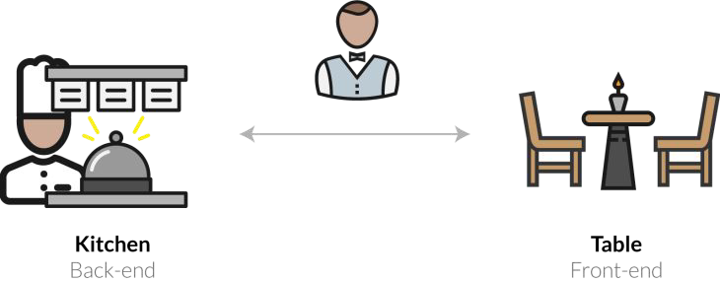
Frontend & Backend
Websites are often delivered by two distinct sets of technology, known commonly as the frontend and backend - or sometimes client side and server side.
This terminology is becoming increasingly blurred in terms of the technology used however the concept generally still applies regardless of technology used.
When you are accessing a website in your browser, what you are seeing and interacting with is known as the frontend. It is the front facing side of our website, it is rendered on the client’s machine and is interacted with via the browser.
Now if you submit a form on that website, such as a registration form, this often will go to a server (the backend) to be processed. Once it has been processed it will return a response that is then displayed to the user.

Slide 29
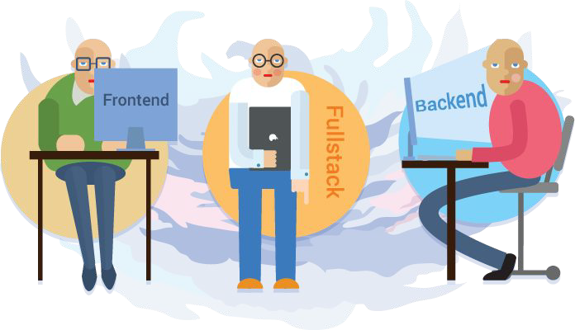
Frontend & Backend
Most commonly these two elements are distinctly programmed and often in different languages with different developers.
Someone that programmes on both the frontend and backend is often referred to as a full-stack developer.
A stack is what we refer to when we are discussing the technology used in a website, this is usually an acronym of technologies used for various parts of the website. A common one is LAMP which stands for: Linux, Apache, MySQL and PHP (2nd year)
On the frontend we are limited by browsers so we must use technology they allow which is HTML, Javascript and CSS.
On the backend however we have more freedom, languages here range from .NET, PHP and Node JS.

Slide 30
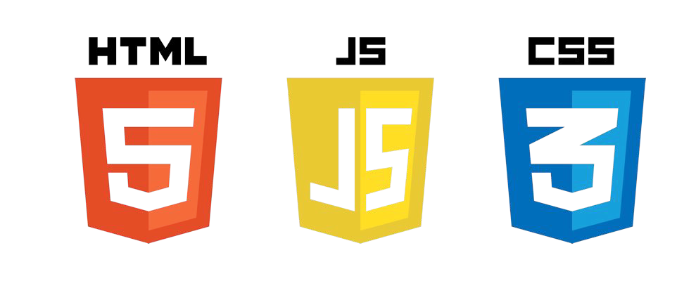
HTML, JS & CSS
This module will primarily be focused on the frontend development of websites. This is the most common learning path into web development due to the fact these languages are a universal standard, whereas backend languages are very much a choice.
The core components of a webpage are the:
HyperText Markup Language JavaScript
Cascading Style Sheets
We will cover all of these in detail over the next few weeks, this week we are looking at HTML.

Slide 31
?

